Slide 1
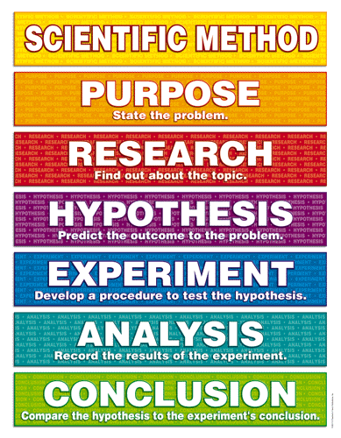
Experimental Design:
The Scientific Method

Slide 2
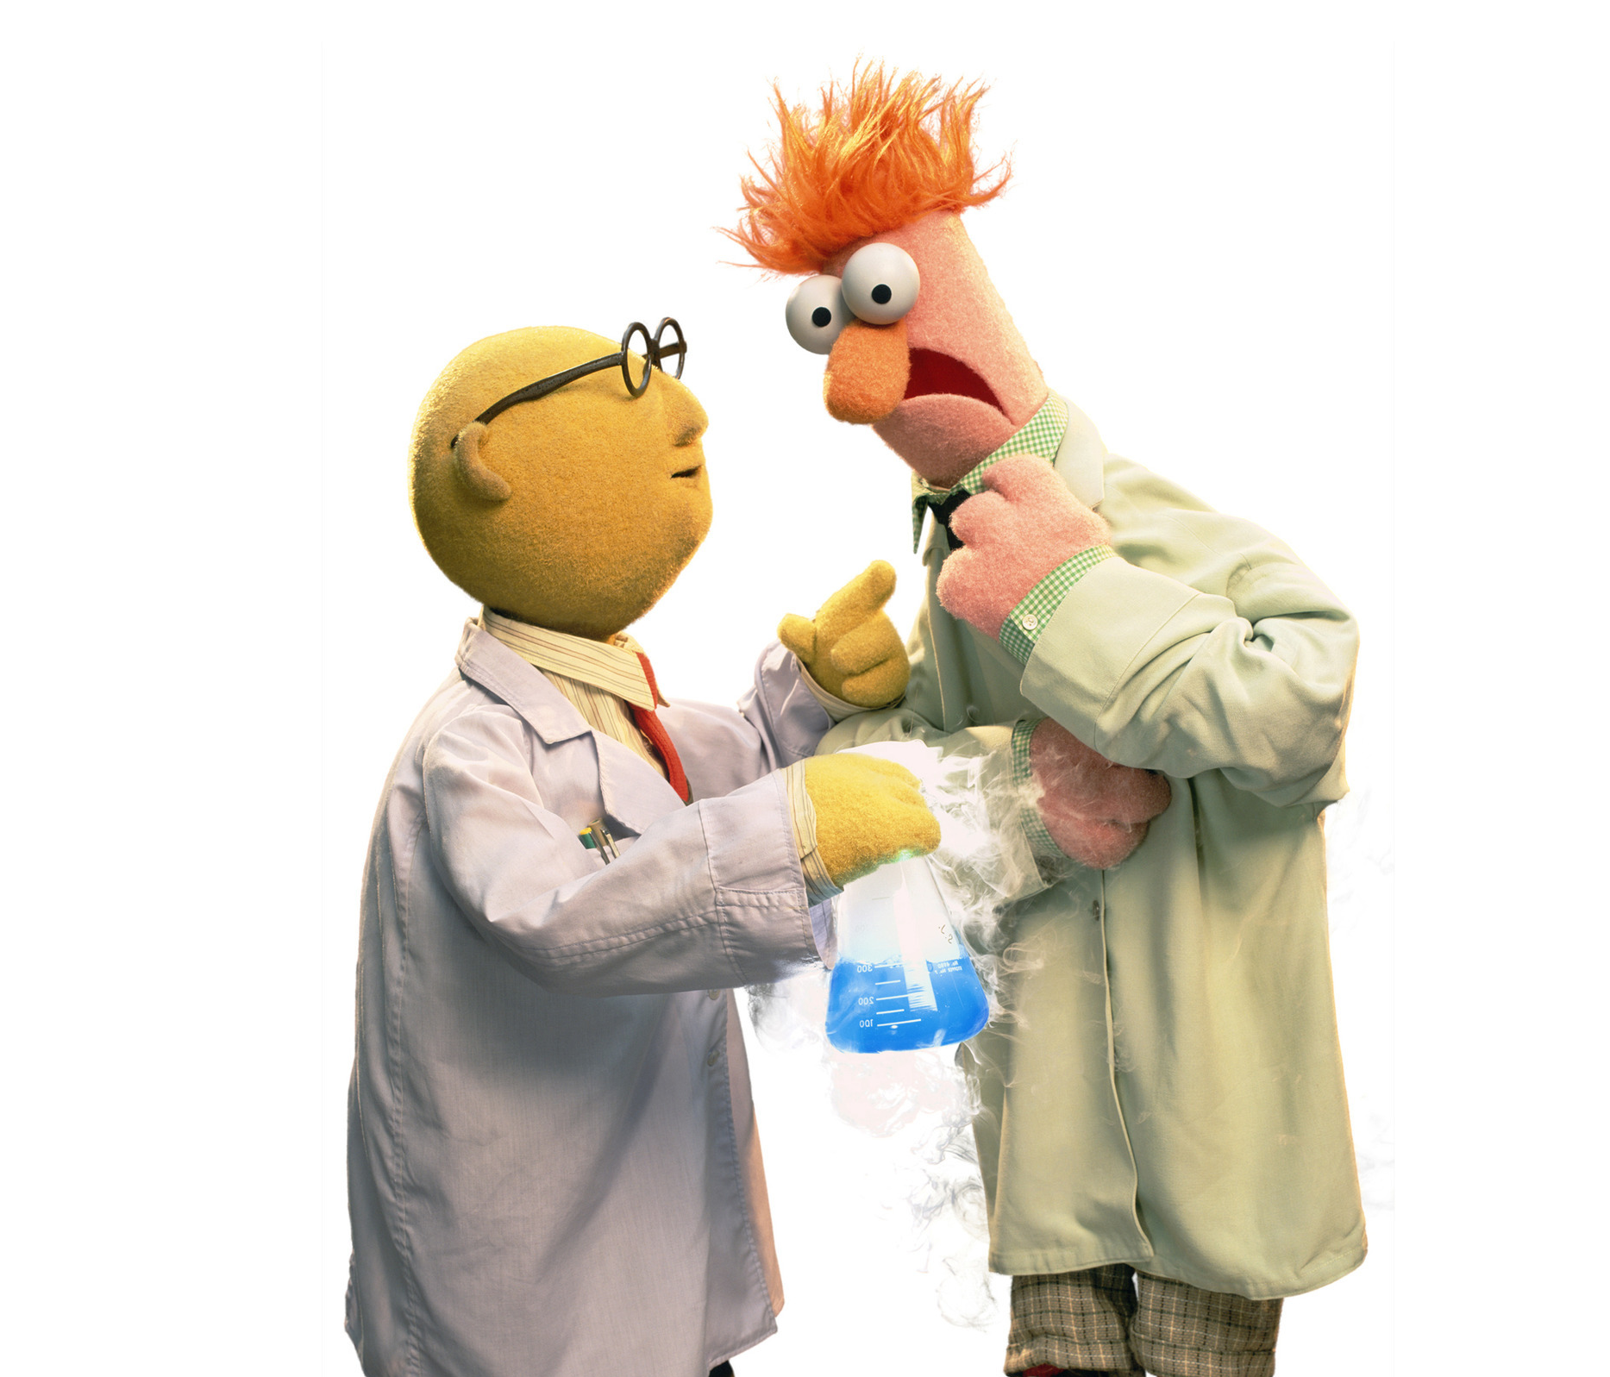
What is the Scientific Method?
A step by step process for conducting an experiment
Makes it possible for other scientists to replicate an experiment

Slide 3
Scientists identify a problem or question that they would like to explore in more detail
The purpose will be presented as:
  What is the effect of ___________________ on _____________________?

Slide 4

Scientists gather information in order to help them make a prediction

Slide 5
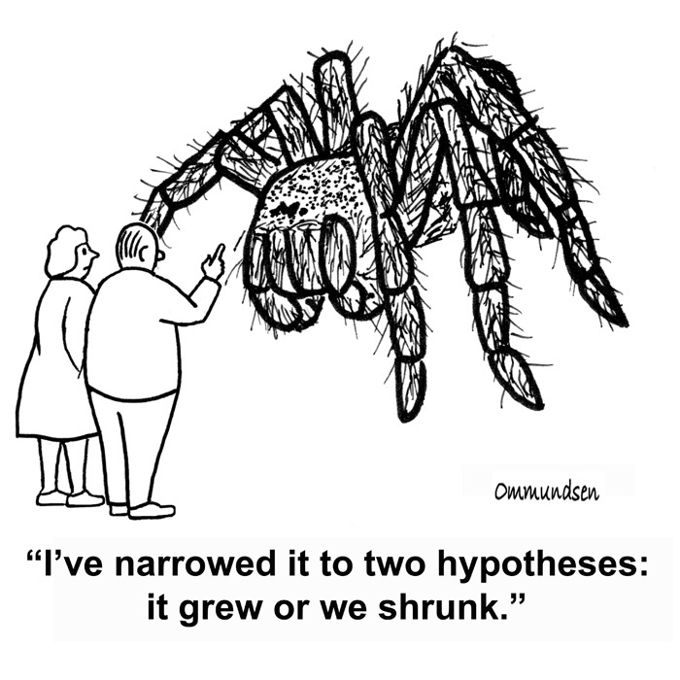
A prediction of what will happen
Must be based on research
Does not have to be correct

Slide 6

Scientists follow a step by step procedure
Includes exact amounts of materials used
  Makes it possible for others to replicate the experiment
Collect quantitative and qualitative data
  Scientists record any experimental errors

Slide 7

Scientists analyze the data that was collected by
  Creating a graph, looking for trends (general change) or patterns (a repeated sequence)
Scientists reflect on how experimental error has affected the results
Scientists look to see if the data supports or rejects their initial hypothesis

Slide 8
Scientists formally write up a summary of their findings that answers the initial problem or question that was asked
  __________________ does/does not have an effect on __________________
They identify ideas for future investigation based on the results from their experiment
Refine their hypothesis

